Slide 1

Data Representation and Analysis
Session 2: Working with Data Tables
Hasitha Pramuditha

Slide 2

Welcome Back to Session 2!
Last time, we learned Python basics: variables, numbers, text, lists, and simple functions like print() and len().
We also got hands-on with Jupyter notebooks.
Hands on experience in numpy.

Slide 3

Today's Journey: Working with Tables
Learning Objectives:
Understand what data tables are and how to use them.
Learn pandas basics for spreadsheet-like data.
Load data from files and explore it.
Perform simple data operations.

Slide 4
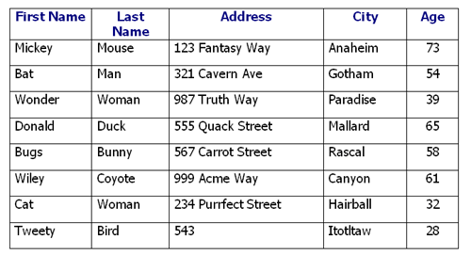
What are Data Tables?
Think of them just like Excel spreadsheets!
Organized into rows and columns.
Each row is one record (e.g., one student, one sale transaction, one survey response).
Each column is one type of information (e.g., Name, Age, Product, Price).

Slide 5
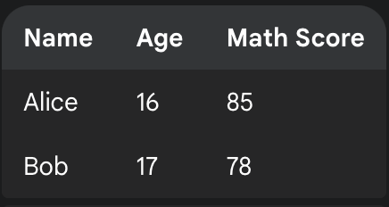
Rows are Records
Imagine a class roster:
Each student is a row.
All the information about that specific student is in their row.
It's a complete entry!

Slide 6
Columns and Information Types
Each column holds one specific type of data for all records.
In our class roster, 'Name' is a column, 'Age' is a column, 'Math Score' is a column.
It helps us organize and compare data easily.

Slide 7

Real-World Data Table Examples
Student Records: Name, Age, Grades, Favorite Subject
Sales Data: Product, Price, Quantity, Store, Date
Survey Responses: Question 1 Answer, Question 2 Answer, Demographics
Weather Data: Date, Temperature, Humidity, Precipitation

Slide 8

Introducing Pandas: Our Data Table Super-Tool!
Pandas is a Python library (a collection of pre-written code) specifically designed for working with data tables.
It makes it really easy to read, manipulate, and analyze structured data.
Think of it as your digital spreadsheet software but with the power of Python!

Slide 9
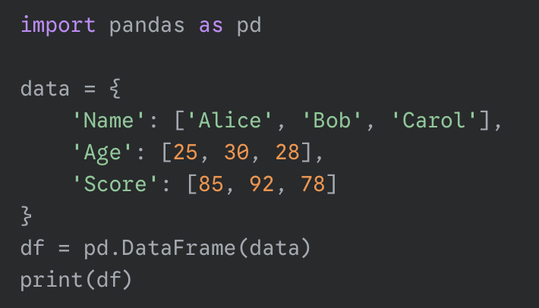
The DataFrame
In Pandas, our data tables are called DataFrames.
It's the core object we'll use for everything.
We often import pandas with the shorthand pd.

Slide 10
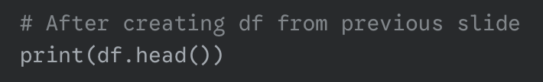
Basic DataFrame Exploration
When you have a big table, you don't want to print the whole thing.
df.head() shows you just the first few rows (default is 5).
Great for a quick peek at your data!

Slide 11

Basic DataFrame Exploration
df.info() gives you a summary of your DataFrame.
It tells you:
Number of rows and columns.
Column names.
How many non-missing values are in each column.
The type of data in each column (e.g., number, text).

Slide 12

Basic DataFrame Exploration
df.shape tells you the number of rows and columns as a pair of numbers.
It's super quick and handy!
Output format: (rows, columns)

Slide 13

Loading Data from Files: CSV Files
Most data you'll work with won't be typed by hand.
CSV (Comma Separated Values) files are common for data.
They are like simple spreadsheets saved as plain text.
Each value is separated by a comma.
You can open them with Excel or a text editor!

Slide 14

Loading Data with pd.read_csv()
This is the magical command to load a CSV file into a DataFrame!
You just need to tell it the file's name (and its location).
Example:
students =pd.read_csv('students.csv')

Slide 15

Understanding File Paths and Locations
Where is your file? Python needs to know!
Best Practice for now: Put your CSV file in the same folder as your Jupyter notebook.
If not, you'll need the full path (e.g., 'C:/Users/YourName/Documents/data/students.csv').

Slide 16
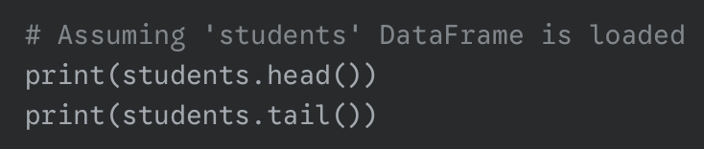
Basic Data Exploration: First & Last Rows
Once loaded, we can immediately check the data.
df.head(): Shows the first 5 rows.
df.tail(): Shows the last 5 rows.
Helps you confirm the data loaded correctly and spot any issues at the beginning or end.

Slide 17
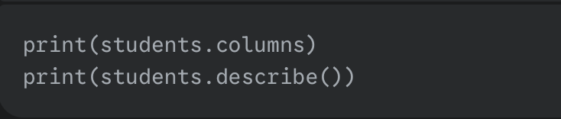
Column Names & Basic Statistics
df.columns: Gives you a list of all the column names. Useful for double-checking typos!
df.describe(): Provides basic statistics for numerical columns (count, mean, standard deviation, min, max, quartiles).
This is your first step to understand the numbers in your data!

Slide 18
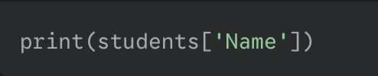
Selecting Data: One Column
How do we get just the 'Name' column?
Use square brackets with the column name in quotes: df['Column Name’]
This gives you a Series (a single column of data).

Slide 19
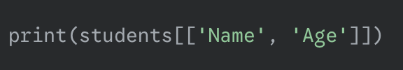
Selecting Data: Multiple Columns
What if you want 'Name' and 'Age' together?
Use double square brackets and put a list of column names inside: df[['Col1', 'Col2’]]
This gives you a new DataFrame with just those columns.

Slide 20
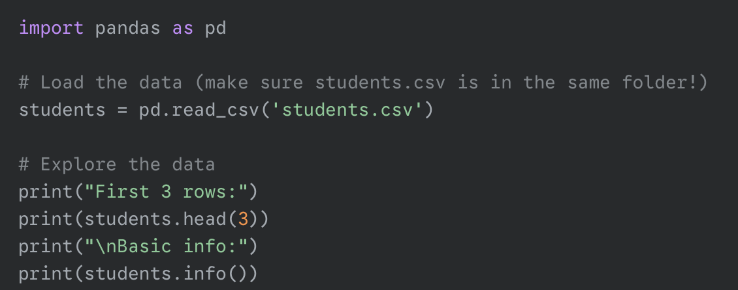
Activity 1: Loading & Initial Exploration
We'll use a students.csv dataset.
Practice loading the data.
Practice exploring it with head(), info(), describe(), and column selection.

Slide 21
Tasks:
Load the data from movies.csv.
Get a quick look of the first 3 rows and last 2 rows.
Inspect the structure of the DataFrame.
How many rows and columns in the dataset?
What are the column names?
Provide a statistical summary of the numeric columns.
Select the “Genre” column only and assign it to a DataFrame named genre.
Select the “Year” and “Rating” columns and assign them to a DataFrame named df1.
Calculate rating per minute and add it as a new column called RatingPerMinute.

Slide 22
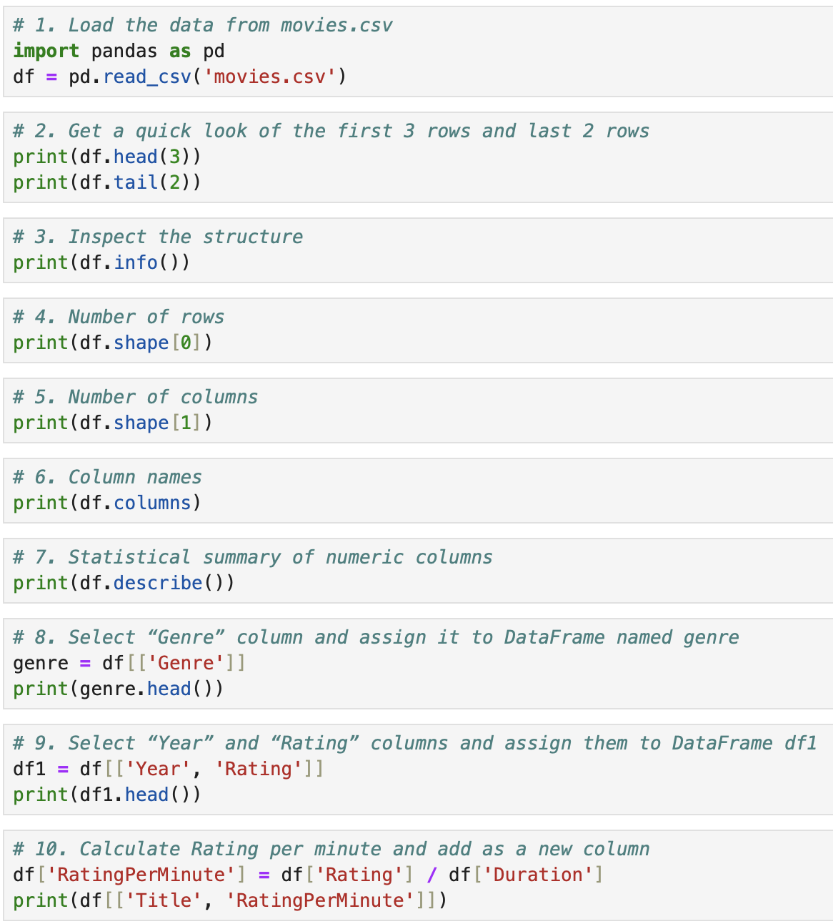

Slide 23
Q & A

